Slide 1
Science Mission Directorate
Class D Town Hall
Thomas H. Zurbuchen
Associate Administrator
Gregory L. Robinson
Deputy Associate Administrator for Programs
JANUARY 2018

Slide 2
SOLAR
SYSTEM
JASD
HELIOPHYSICS
ASTROPHYSICS
EARTH

Slide 3
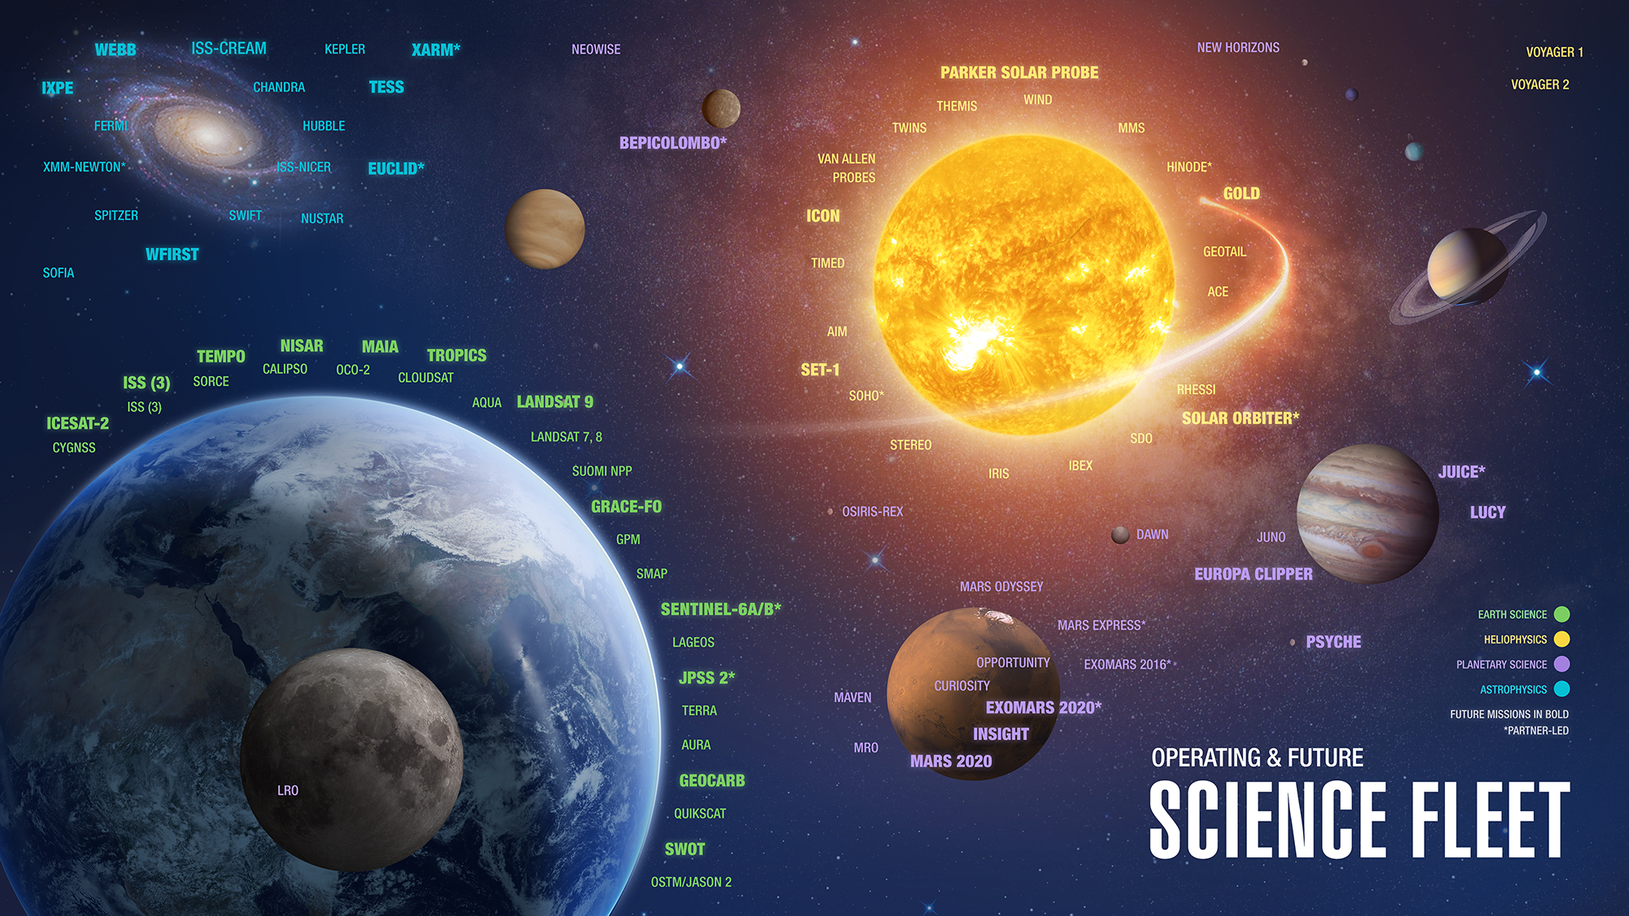

Slide 4
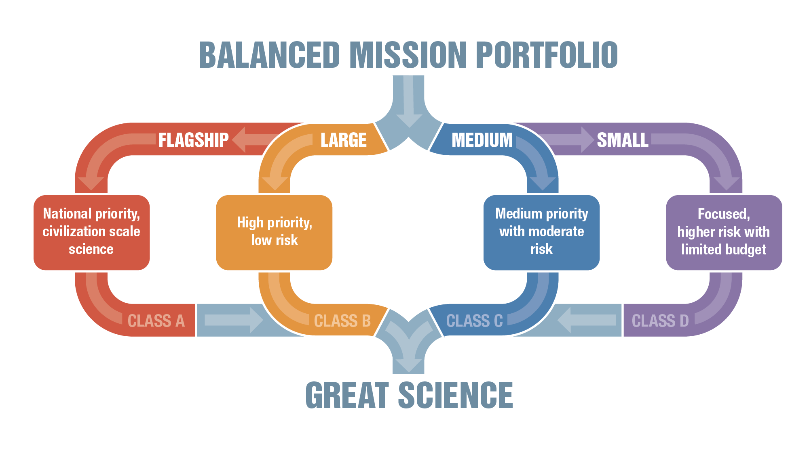

Slide 5
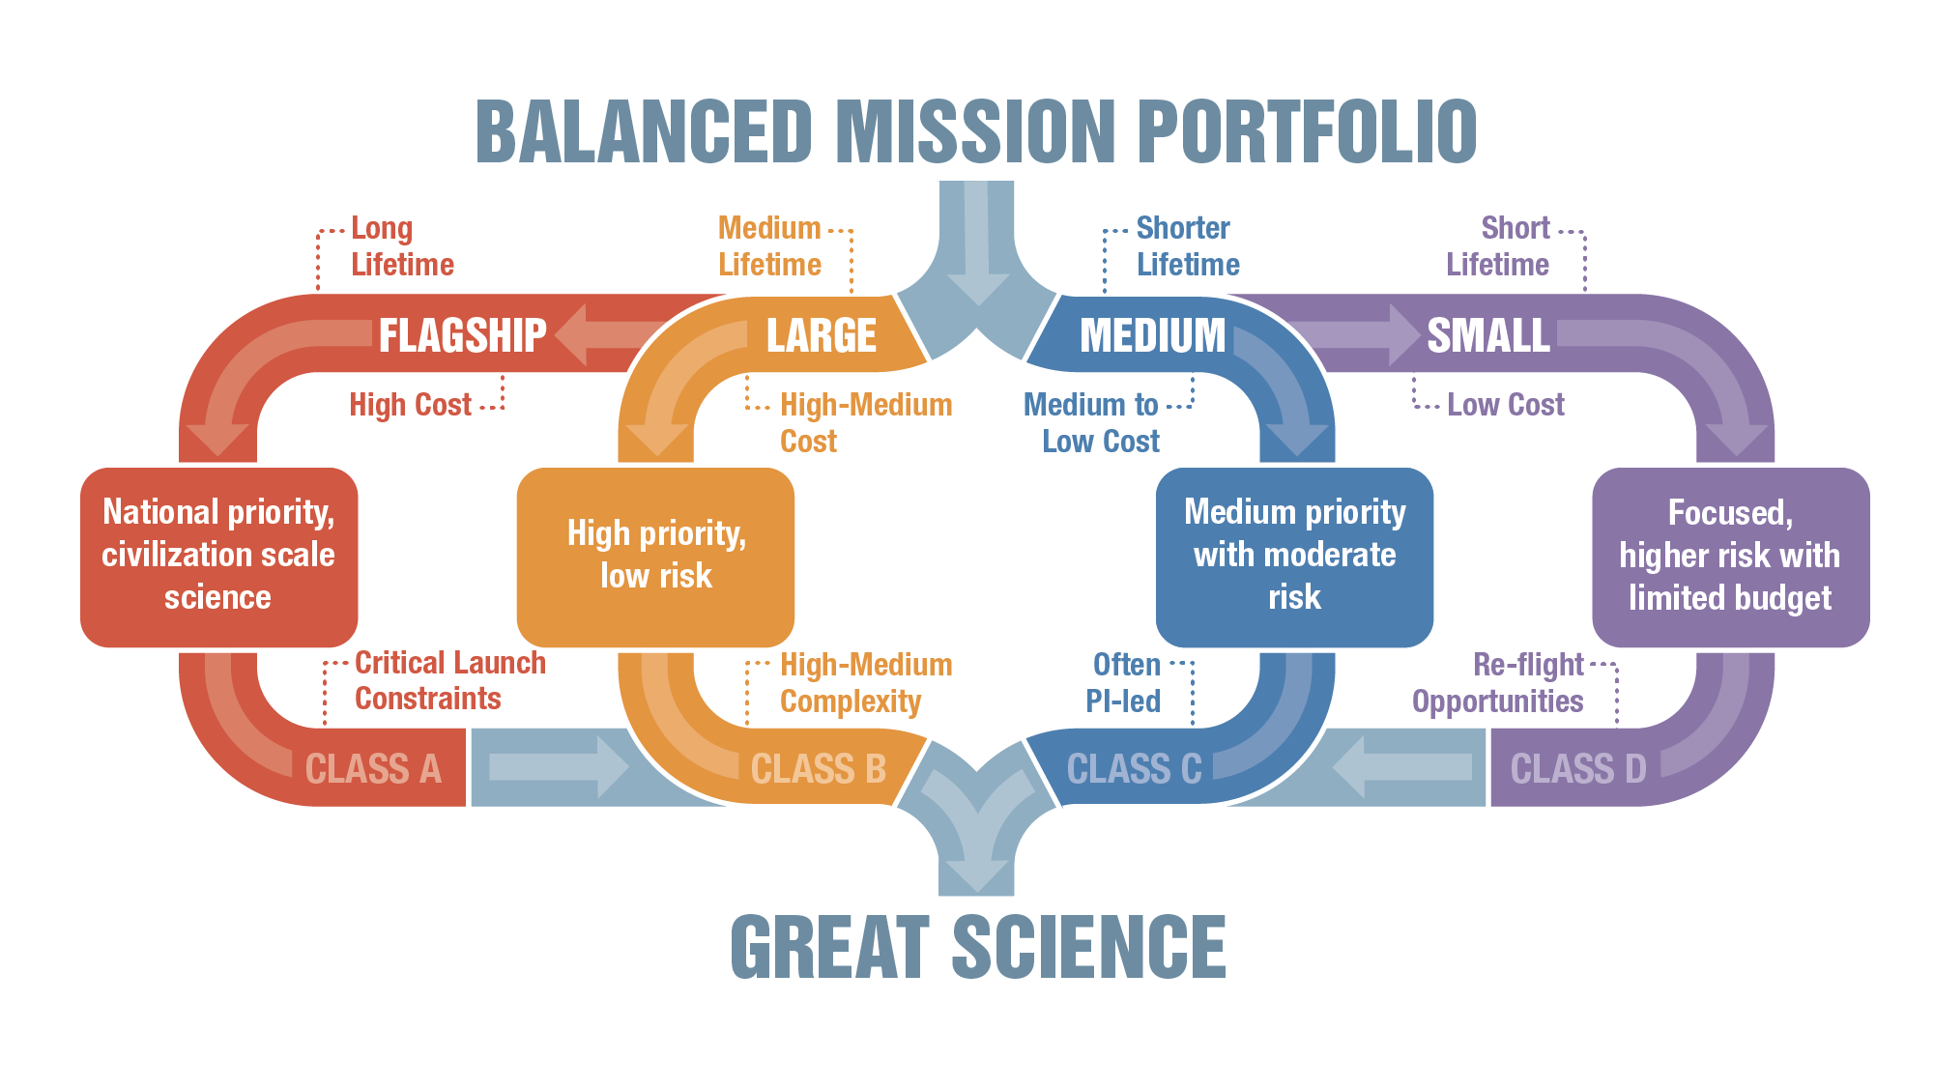

Slide 6
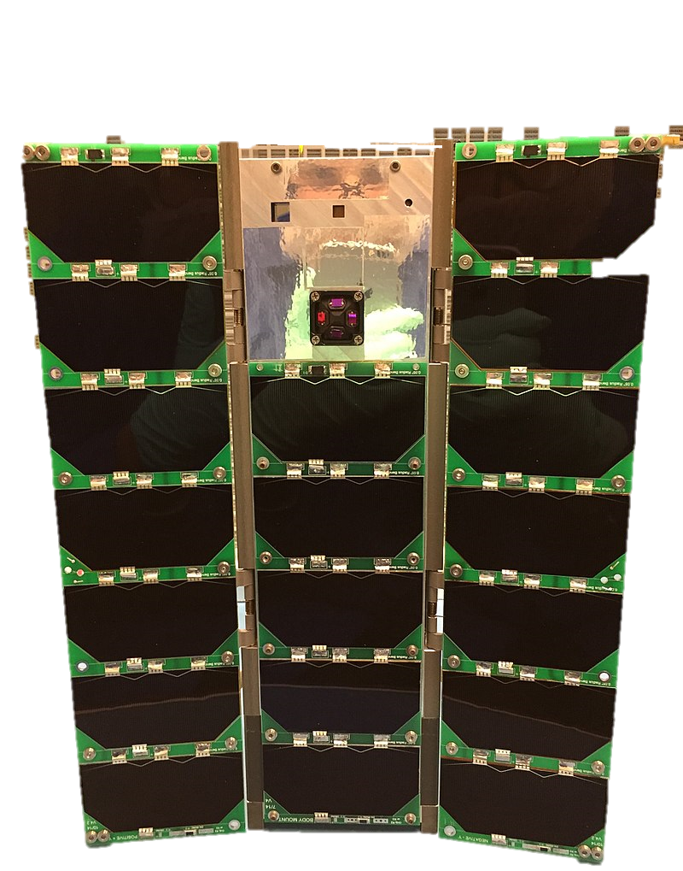
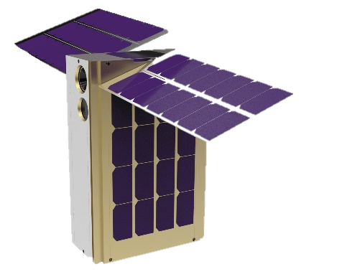
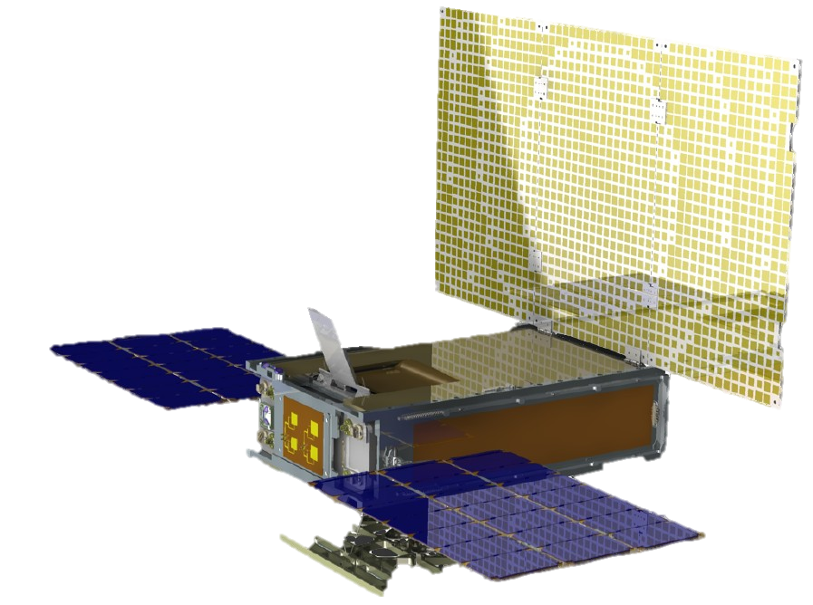
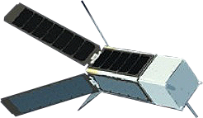
Importance of Small,
Innovative Missions
Expand science programs to take advantage of small satellite rapid innovation to achieve breakthrough science
Enable fast access to space with focused science measurements to fill a critical gap between large flight projects
Leverage technology investments to further improve potential of science instruments
Partner with commercial entities to acquire new capabilities of small satellite platforms

Slide 7
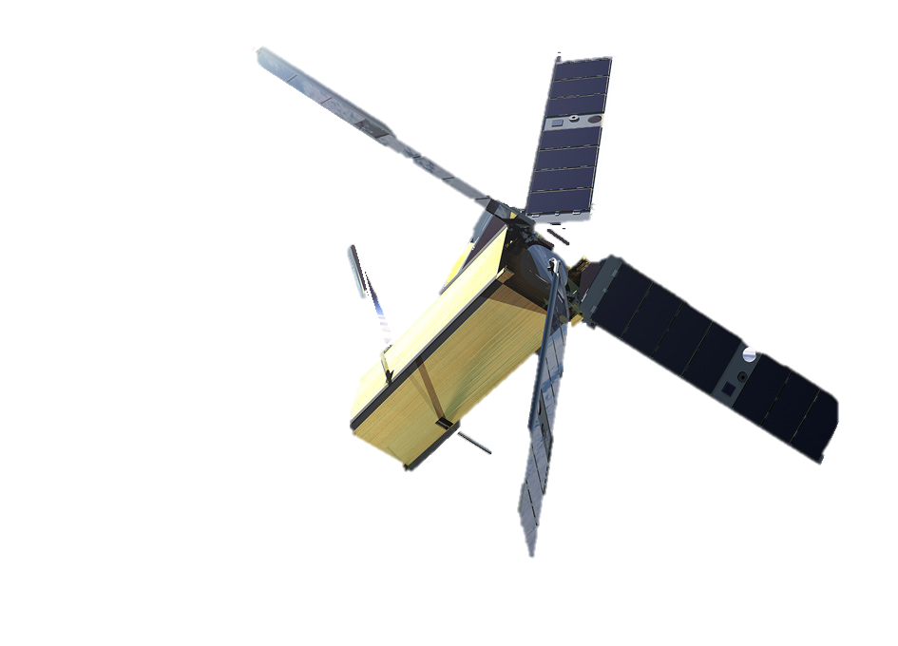
Class D Examples
CYGNSS
MinXSS
RAVAN
IN FLIGHT
LunaH-Map
TROPICS
MarCO
IN DEVELOPMENT

Slide 8
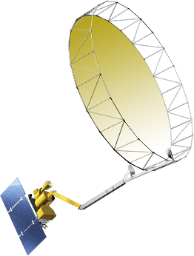
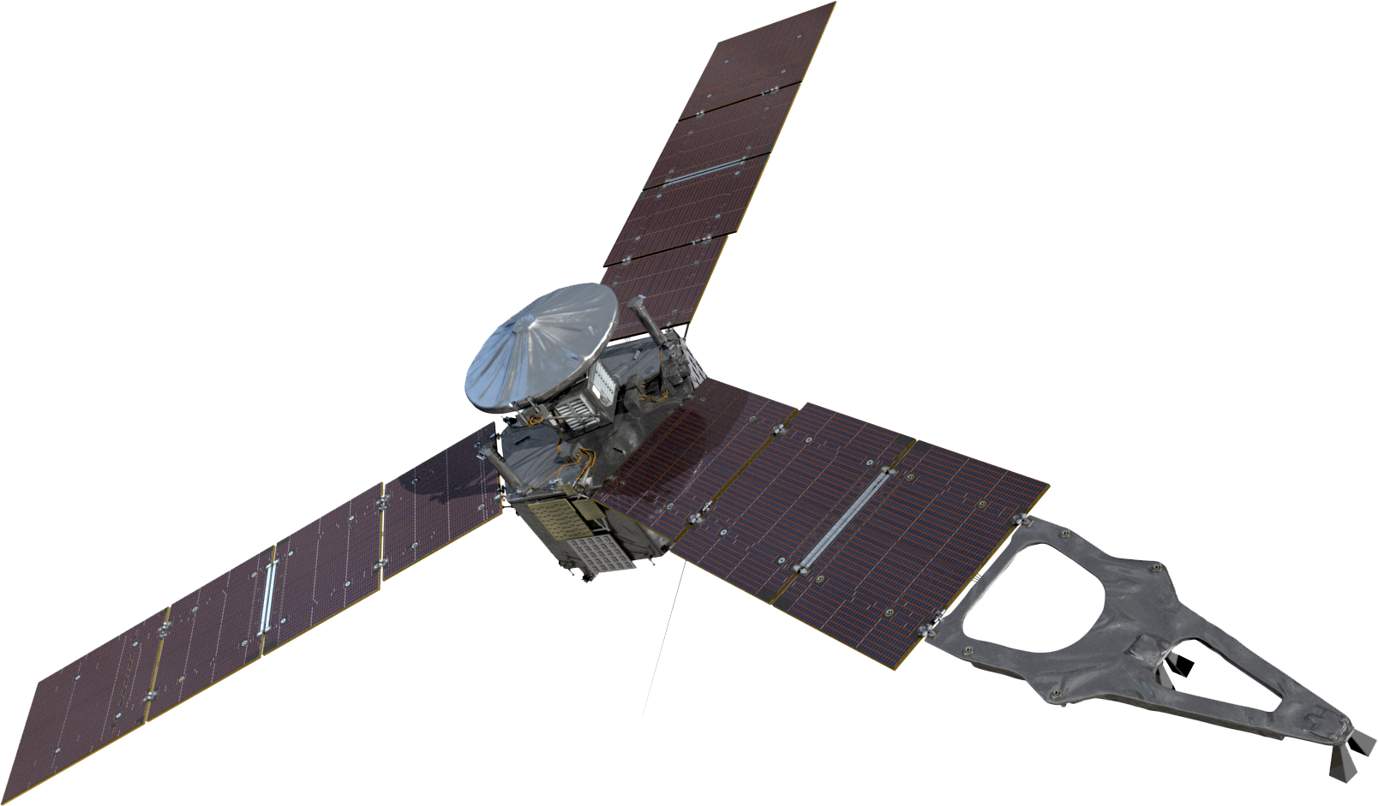
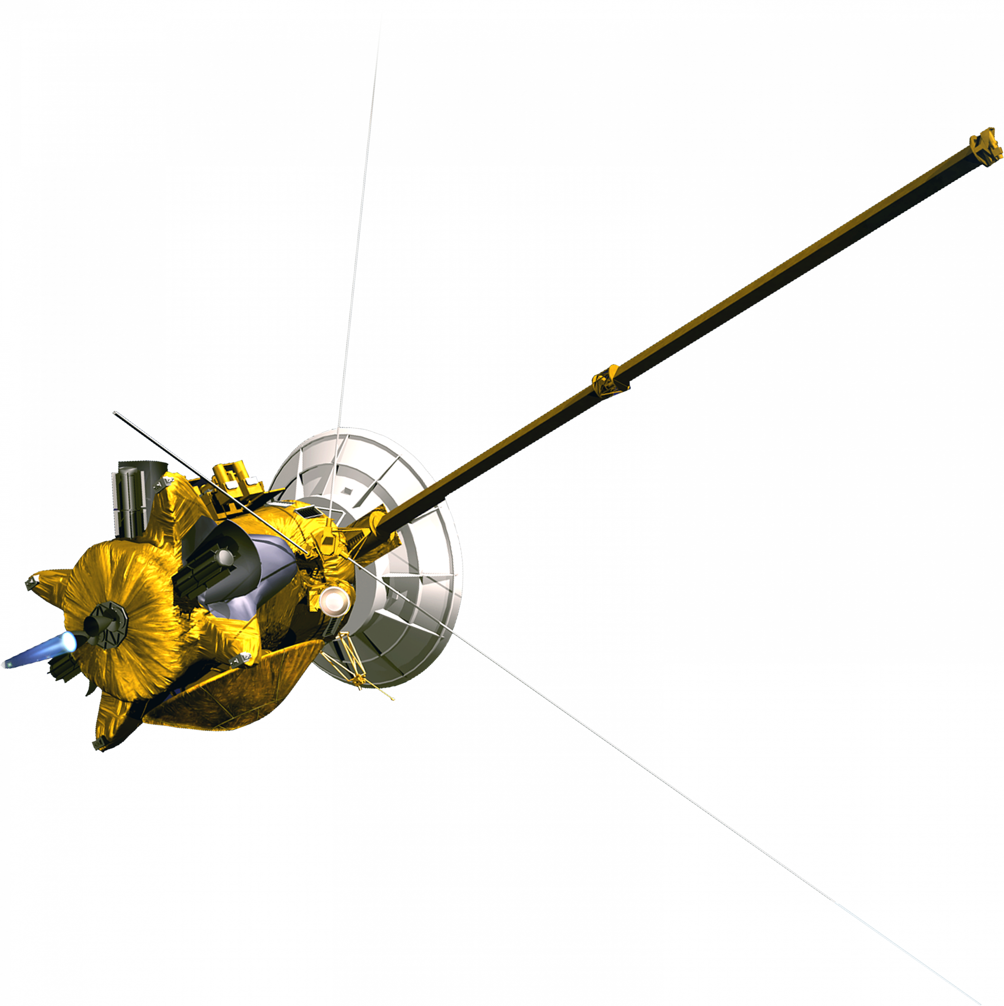
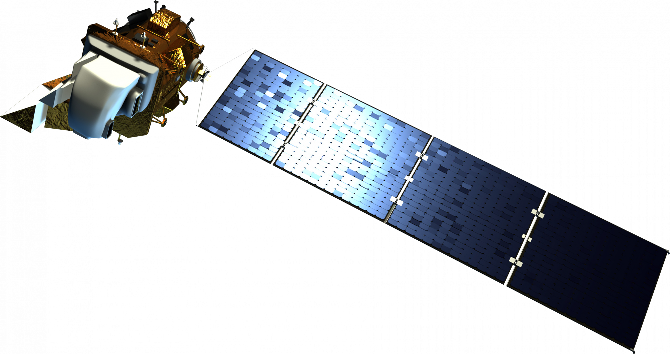
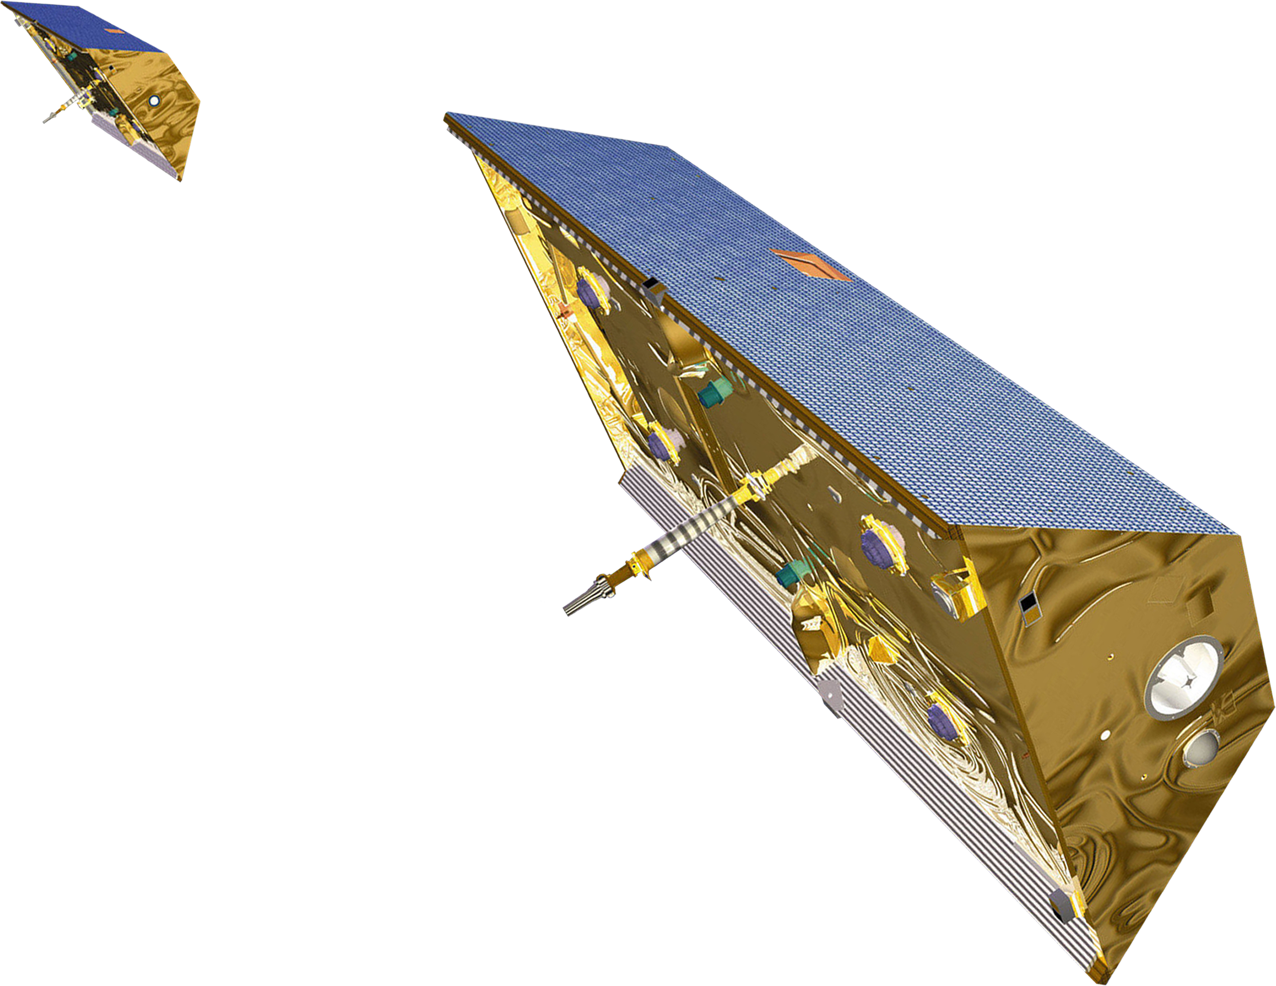
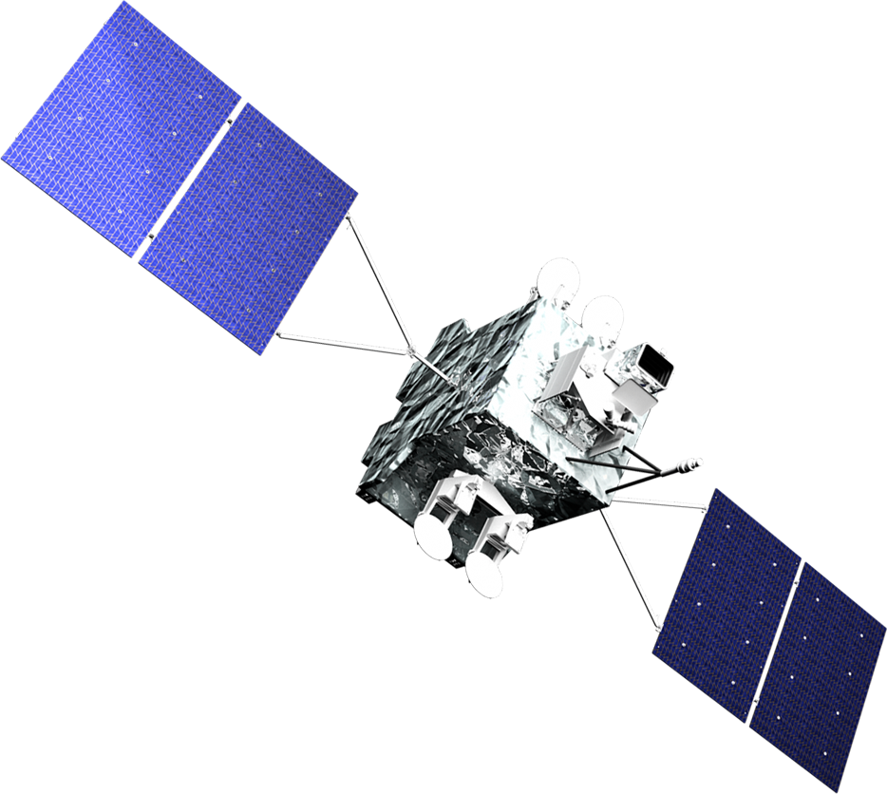
SMD Portfolio Defined
CLASS A
CLASS B
CLASS C
CLASS D
High priority
Very high significance
High complexity
Long mission lifetime
High cost
Critical launch constraints
No re-flight opportunities
High priority
High significance
High to medium complexity
Medium mission lifetime
High to medium cost
Medium launch constraints
Medium priority
Medium significance
Medium to low complexity
Short mission lifetime
Medium to low cost
Few launch constraints
Low priority
Low to medium significance
Short mission lifetime
Medium / low complexity
Low cost
Few to no launch constraints
Re-flight opportunities
Cassini
Webb
Europa Clipper
Mars 2020
Juno
Landsat-9
InSight
OSIRIS-REx
Parker Solar Probe
MMS
ICESat-2
TESS
GRACE Follow-on
ICON
CYGNSS
NICER
TROPICS
GeoCarb
ECOSTRESS

Slide 9
Class D Strategy Implementation
Accepting higher risk for scientific gain by implementing a tailored, streamlined classification approach
Reviews
Documentation
MANAGING RISK WHILE MEETING THE MISSION
Tech
Approach
Performance Measurements
9

Slide 10
SMD Implementation Reviews
Lifecycle Reviews conducted by project implementing institution
Only two NASA required reviews during the Project development lifecycle
Delegated Decision Authority
Review Teams as small as practicable

Slide 11
SMD Implementation Documentation
Only final documentation submitted to NASA HQs for approval; no preliminary documentation
Final Project documentation approved at the Division Director level
Merging documentation encouraged
Tailoring Mission Assurance Requirements (MAR), with a goal to reduce documentation deliverables and reviews

Slide 12
SMD Implementation Performance Management
Formal Earned Value Management (EVM) and a certified EVM system is not required
NASA will develop only one NASA ICE/ISE
KDP-C decision will be made based on 60% confidence levels, and not based on the usual 70%
7 Basic principles apply: Per Robert Lightfoot memo 9/26/14, AO website: https://soma.larc.nasa.gov/standardao/
Notes:
7 Basic principles apply:
Plan all work scope to completion using a Work Breakdown Structure (WBS)
Break down work scope into finite pieces specifically assigned for technical, schedule and cost objectives
control
Integrate program work scope, schedule, and cost objectives into performance measurement baseline
Use actual costs incurred and recorded
Assess accomplishments at work performance level
Analyze significant variances, forecast impacts, and prepare estimate at completion based on performance to date and remaining work performed
Use EVMS information in the organization's management processes

Slide 13
Questions
Information can be found at https://soma.larc.nasa.gov/standardao/ClassD.html
Contact Gregory.l.robinson@nasa.gov with questions and comments

Slide 14
Science Mission Directorate
Class D Town Hall
Thomas H. Zurbuchen
Associate Administrator
Gregory L. Robinson
Deputy Associate Administrator for Programs
JANUARY 2018

